Slide 1
Nearest Neighbor Classification
Data Set: wbcd.csv

Slide 2


Load Data

Slide 3
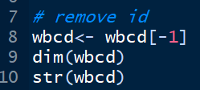

Remove id as it cannot be a independent variable

Slide 4

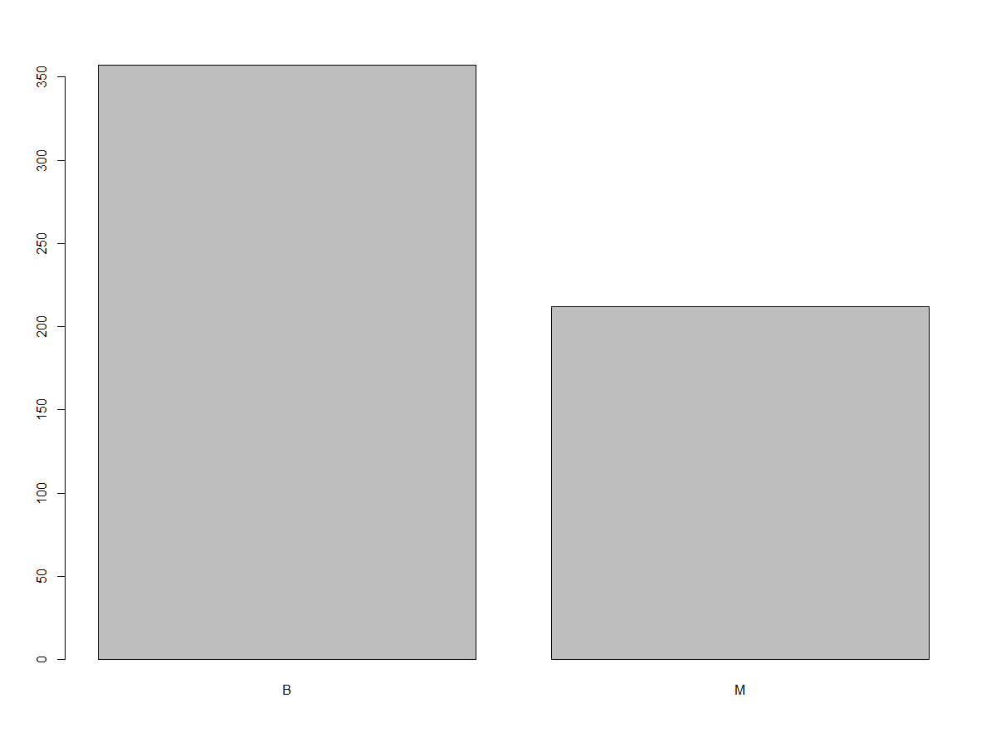

Find counts in diagnosis

Slide 5

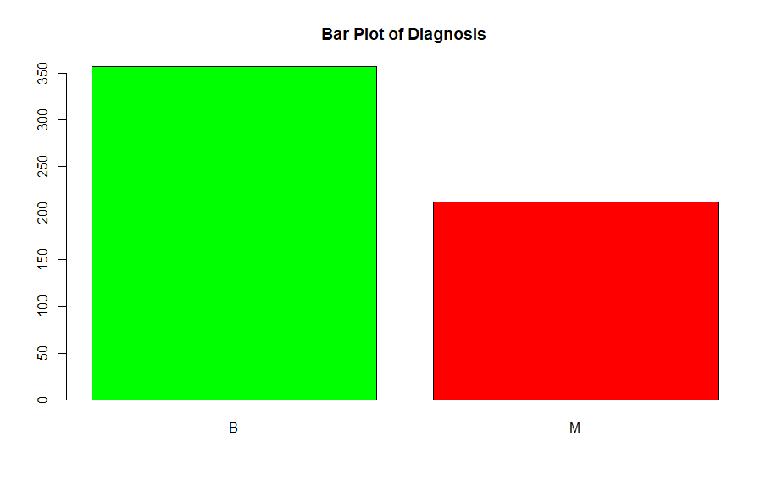
Lets color

Slide 6

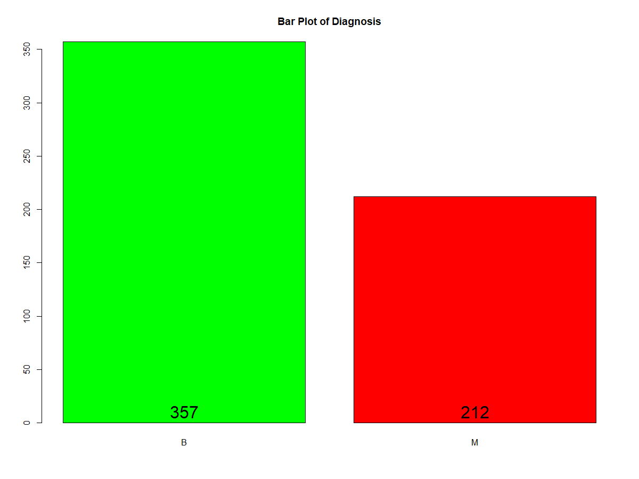
Lets have counts inside

Slide 7



Lets write full forms of B and M

Slide 8


Proportions in diagnosis

Slide 9


Create a function and test it

Slide 10



Normalize the data

Slide 11

Train and Test data
But how we will compare results or membership?

Slide 12




Creating new vector/df having all needed rows and only 1st column as diagnosis

Slide 13
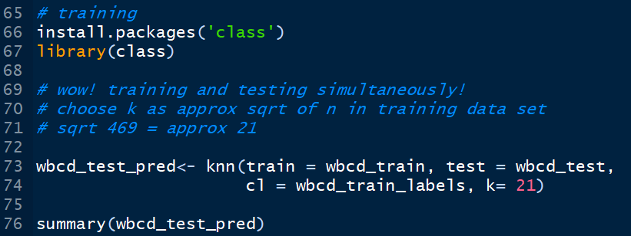

Apply knn

Slide 14

Evaluate Model

Slide 15
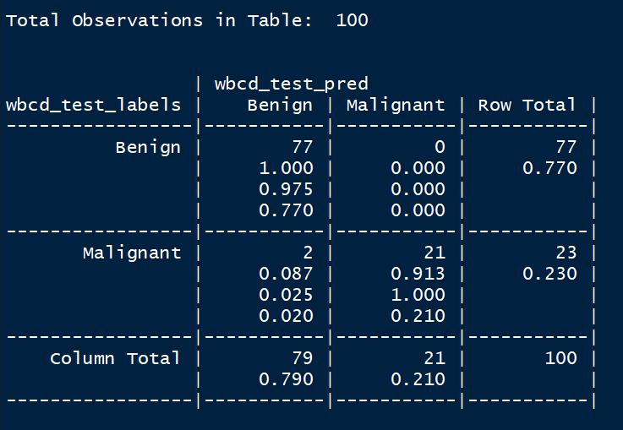
Cross Tabulation for comparing

